Slide 1
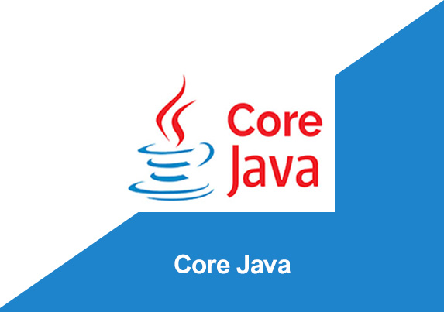
By: Manas Tuwani

Slide 2
DATA TYPES
We are using data types to preserve or allocate space for the variables into memory. That is the reason while creating the variables we should specify the data type in Java so that based on the data type system allocates the space to the variable into memory.
Data types specify the different size of value that can be stored in the variables.
There are two types of data types in Java: Primitive data types:
The primitive data types include boolean, char, byte, short, int, long, float and double.
Non-primitive data types: The non-primitive data types include Classes, Interfaces, and Arrays.

Slide 3
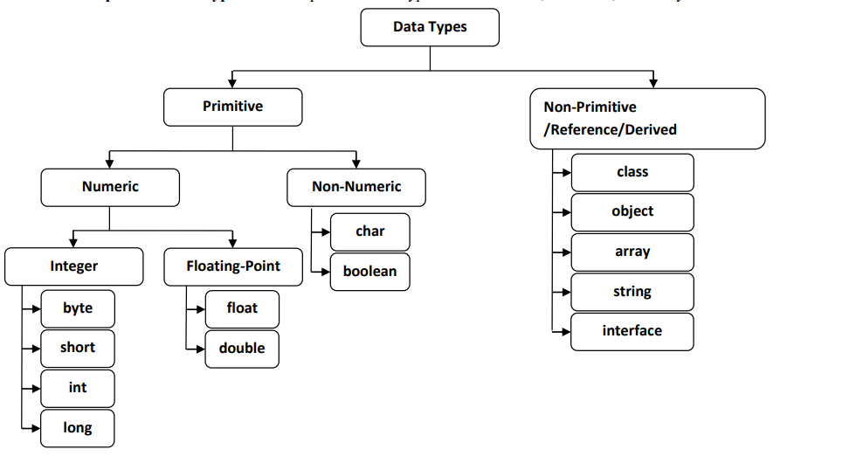
Data Types

Slide 4
Primitive Data types
Based on the range there 8 different types of primitive data types available in java.
1. Byte (8 bits datatype) 1 Byte -128 to 127
2. Short (16 bits datatype) 2 Byte -32768 to 32767
3. Int (32 bits datatype) 4 Byte -2³² to 2³²-1
4. Long (64 bits datatype) 8 Byte -
5. Double (Decimal value) 8 Byte
6. Float (Decimal value) 4 Byte
7. Char (To store single character) ‘c’ 2 Byte
8. Boolean (To store true/false) 1 Bit

Slide 5
Byte Data Type
The byte data type is an example of primitive data type. It is an 8-bit signed two's complement integer. Its value-range lies between -128 to 127 (inclusive). Its minimum value is -128 and maximum value is 127. Its default value is 0.
Size = 1 byte or 8 bit
Example:
byte a = 10, byte b = -20

Slide 6
Short Data Type
The short data type is a 16-bit signed two's complement integer. Its value-range lies between -32,768 to 32,767 (inclusive). Its minimum value is -32,768 and maximum value is 32,767. Its default value is 0.
Size = 2 byte or 16 bit
Example:
short s = 10000, short r = -5000

Slide 7
Int Data Type
The int data type is a most common 32-bit signed two's complement integer. Its value-range lies between -2,147,483,648 to 2,147,483,647. Its minimum value is - 2,147,483,648 and maximum value is 2,147,483,647. Its default value is 0.
The int data type is generally used as a default data type for integral values.
Size = 4 byte or 32 bit
Example:
int a = 100000, int b = -200000

Slide 8
Long Data Type
The long data type is a 64-bit two's complement integer. Its value-range lies between -9,223,372,036,854,775,808(-2^64) to 9,223,372,036,854,775,807 (2^64 -1)(inclusive). Its minimum value is - 9,223,372,036,854,775,808 and maximum value is 9,223,372,036,854,775,807.
Its default value is 0.
The long data type is used when you need a range of values more than those provided by int.
Example:
long a = 100000L, long b = -200000L

Slide 9
Double Data Type
The double data type is a double-precision 64-bit. The double data type is generally used for decimal values just like float. The double data type also should never be used for precise values, such as currency.
Its default value is 0.0
Example:
double d1 = 12.3 ;

Slide 10
Float Data Type
The float data type is a single-precision 32-bit. It is recommended to use a float (instead of double) if you need to save memory.
Its default value is 0.0
Example:
float f1 = 234.5f

Slide 11
Char Data Type
The char data type is a single 16-bit Unicode character. The char data type is used to store single characters.
Example:
char value1 = 'A’ ;
char value2 = ‘a’;

Slide 12
Boolean Data Type
The Boolean data type is used to store only two possible values: true and false. This data type is used for simple flags that track true/false conditions.
The Boolean data type specifies one bit of information, but its "size" can't be defined precisely.
Default value of Boolean datatype is false
Example:
Boolean one = false;

Slide 13
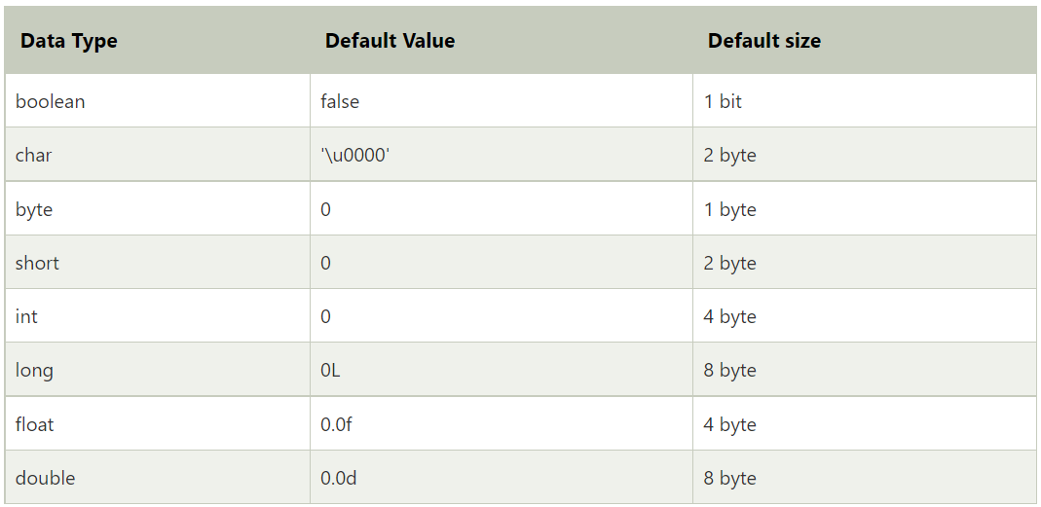

Slide 14
Note:
Operator: We are using to perform the operation.
Data type: We are using to store the values of variable

Slide 15
Output Statements in Java
A statement which we are using to get the output from the program is called output statement.
We are using two different types of output statements in java.
1. System.out.print
2. System.out.println
System.out.print: We are using this statement to get all outputs from program in a single line/same line.
Syntax: System.out.print(variable/“value”);
a=10; b=20; c=a*b;
System.out.print(“c”);
System.out.print(c);
O/p= c200

Slide 16
Output Statements in Java
System.out.println: We are using this statement to get all outputs from the program in line by line.
Syntax: System.out.println(Variable/”value”);
a=10; b=20; c=a*b;
System.out.println(“c”);
System.out.println(c);
O/p= c
200

